Slide 1
Task 5 Implement Deployment Automation (CodeDeploy/Spinnaker)

Slide 2
AWS CodeDeploy
AWS CodeDeploy is a fully managed deployment service provided by Amazon Web Services (AWS). It automates the deployment of applications to various compute services, such as EC2 instances, Lambda functions, and on-premises servers. CodeDeploy makes it easier to release updates, ensuring minimal downtime and reducing the risk of deployment errors.

Slide 3
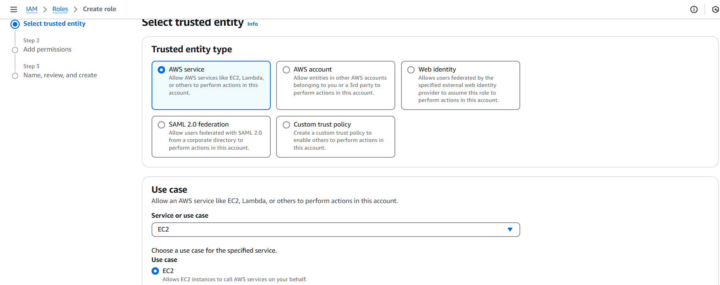
Steps to Implement Deployment Automation using CodeDeploy
Step1: Creating IAM Roles
First create IAM Role by selecting use case as EC2 and set user permissions by selecting as AmazonEC2RoleforCodeDeploy and click on Create IAM Role

Slide 4
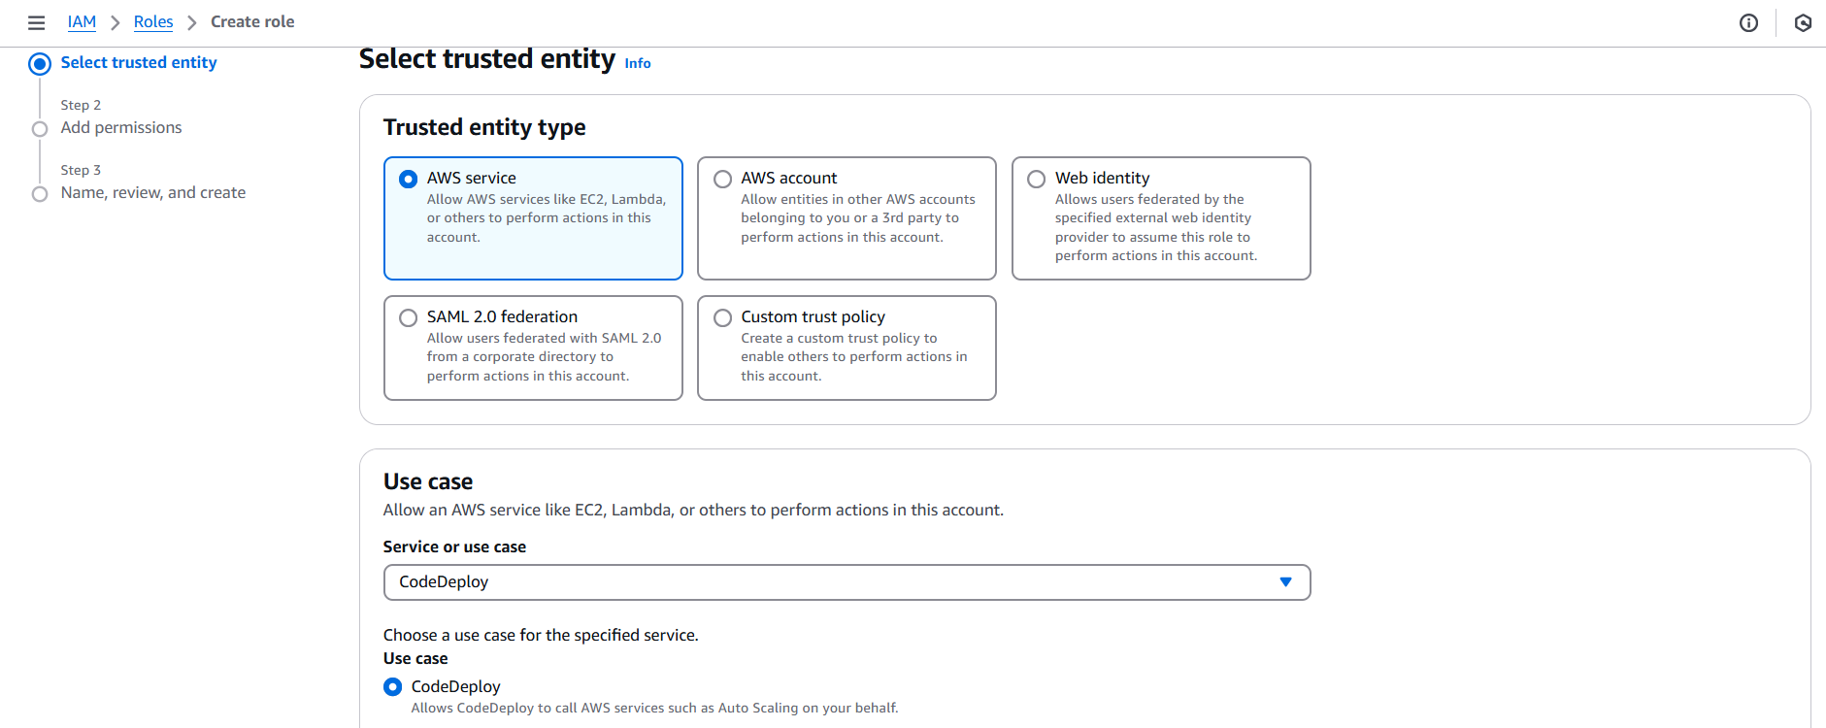
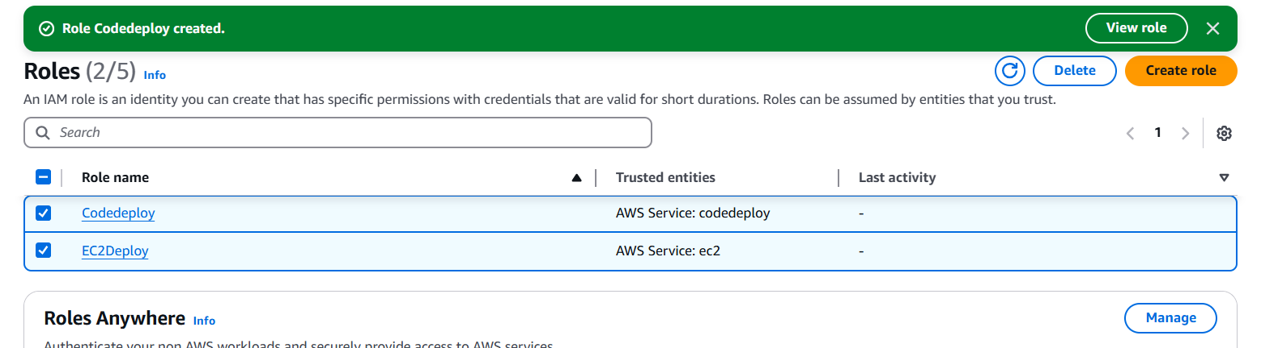
Next create IAM Role by selecting use case as CodeDeploy

Slide 5
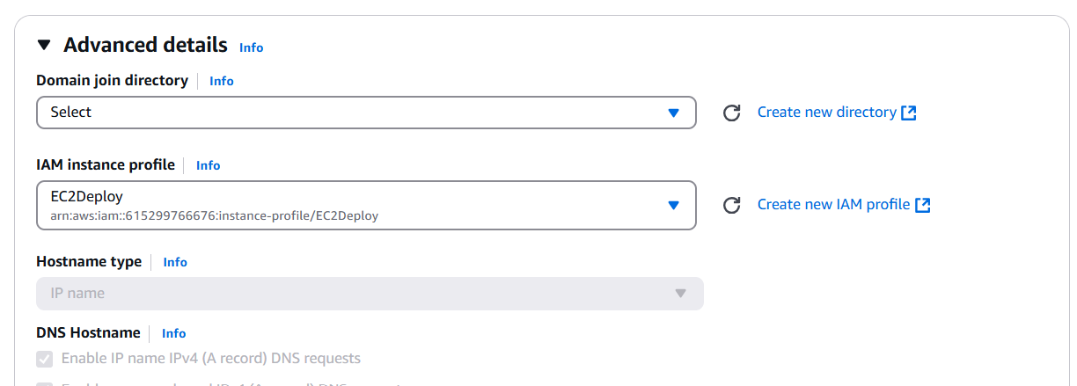
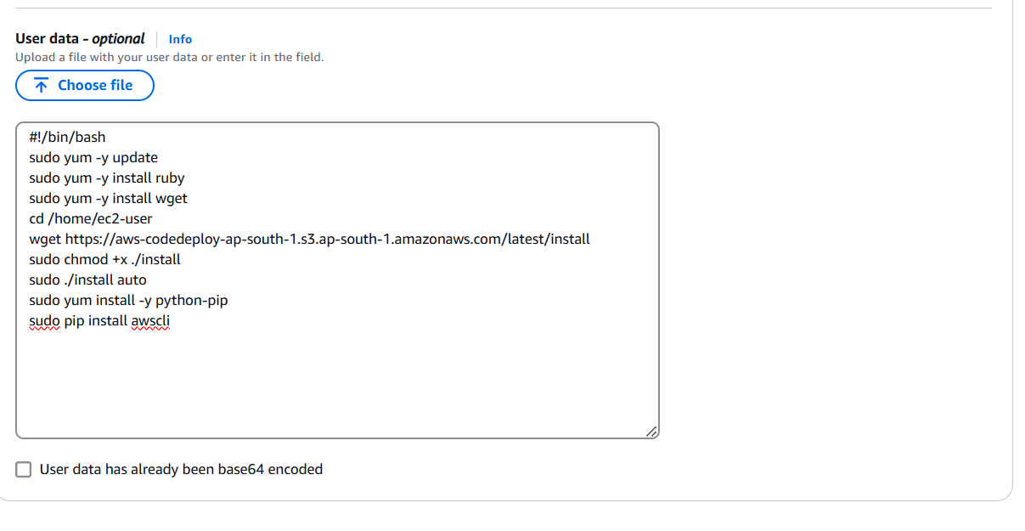
Step2: Create an EC2 Instance and add Created IAM Role from the drop down
also add user data in advanced details then click on Create Instance

Slide 6
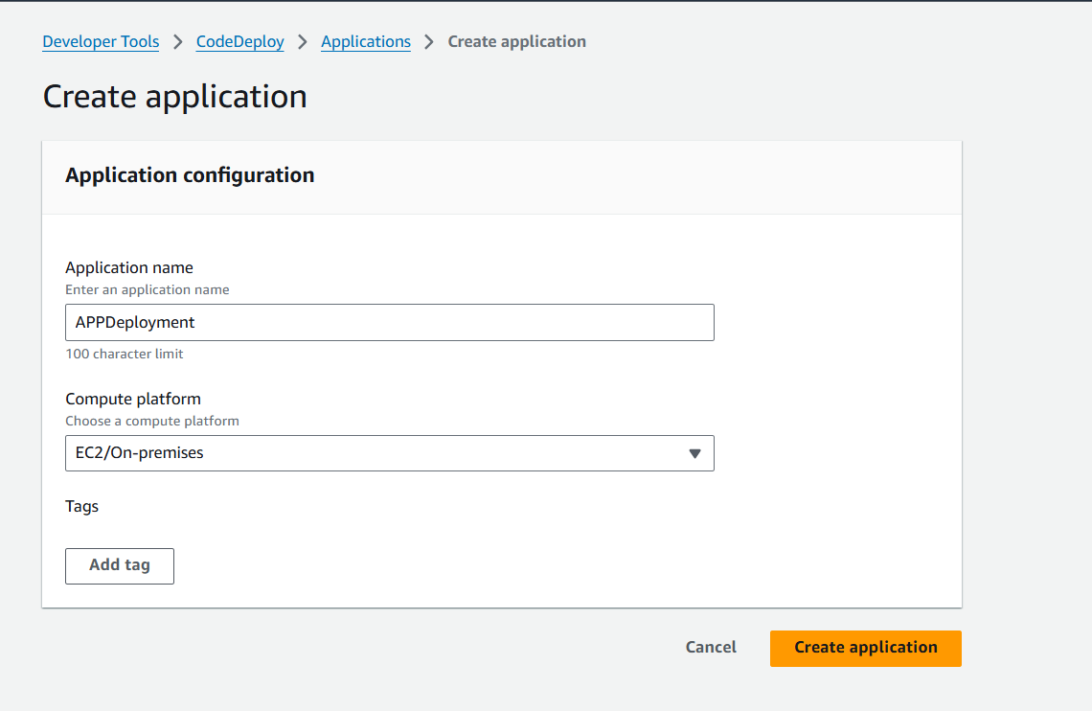
Step3: Navigate to Code pipeline AWS Service. In that first we need to Create Application

Slide 7
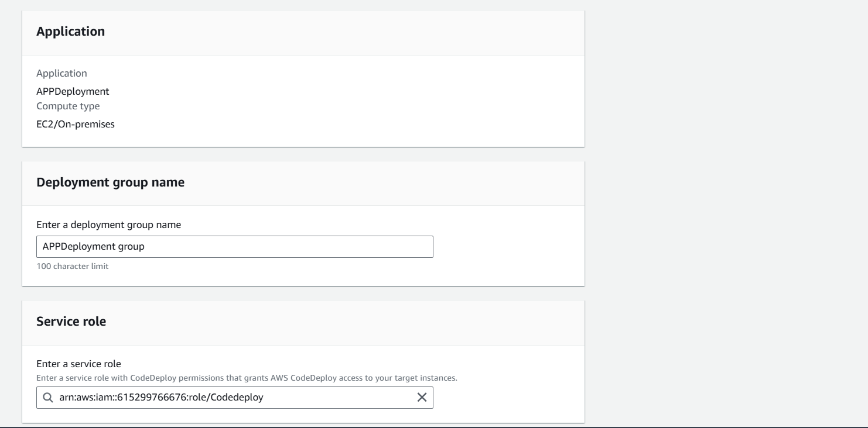
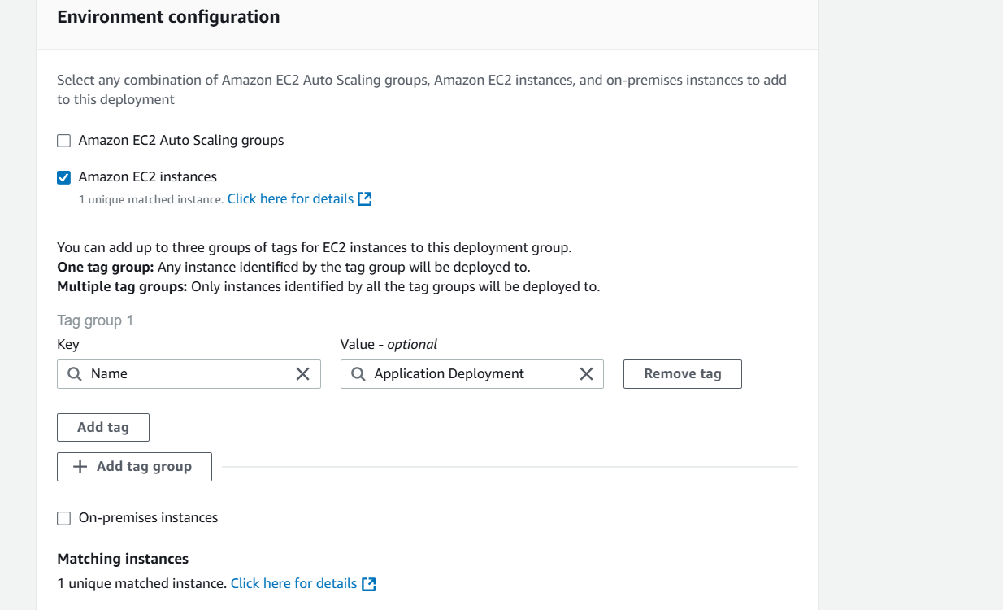
After Creating Application we need to create Application Deployment Group and then select service role from the drop down
As shown in the below Image tick the Amazon EC2 Instance check box and give the Key and value from the drop down and click on create deployment group

Slide 8
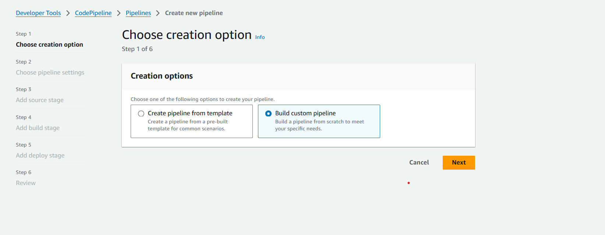
Step4: Create Code Pipeline

Slide 9
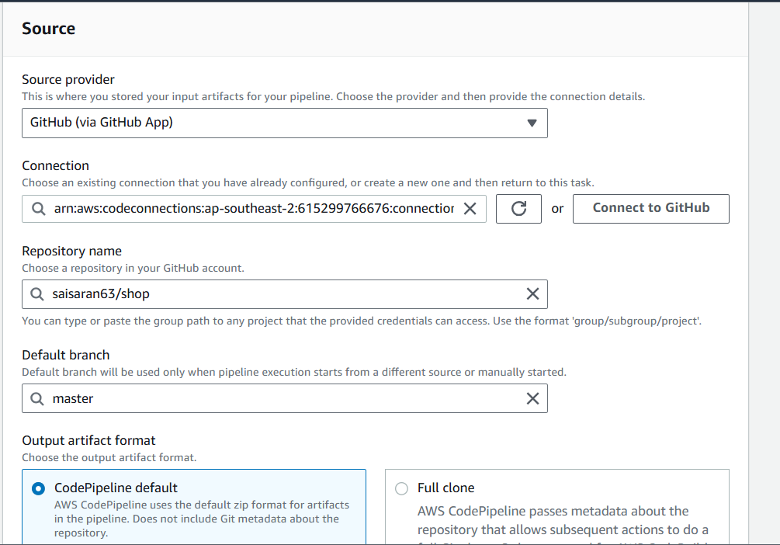
In Step3 add source provider as Github and establish a connection with Github then select Repository which we need to deploy also specify the branch name

Slide 10
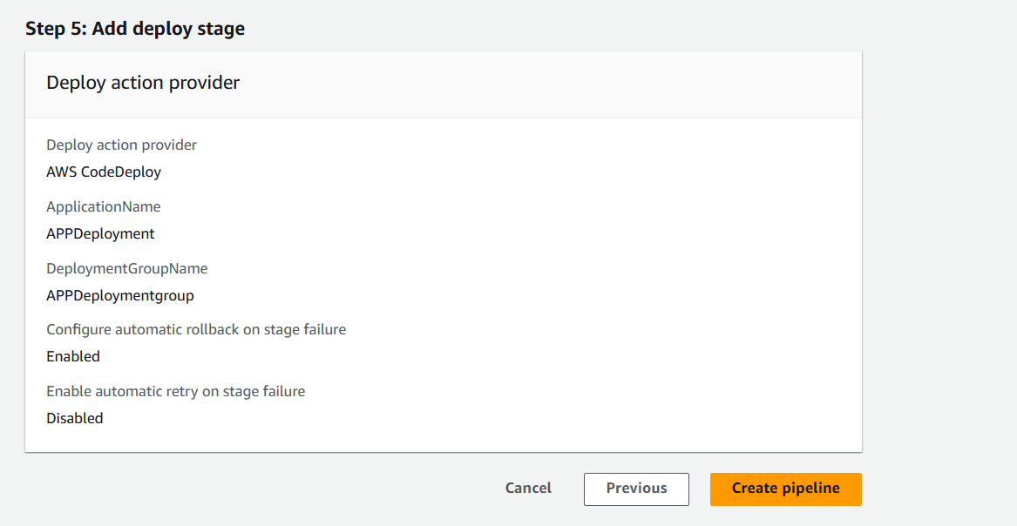
Coming to Step5 Add deploy stage in that we need to add Application and Application Deployment Group that we have created from drop down and then click on create pipeline

Slide 11
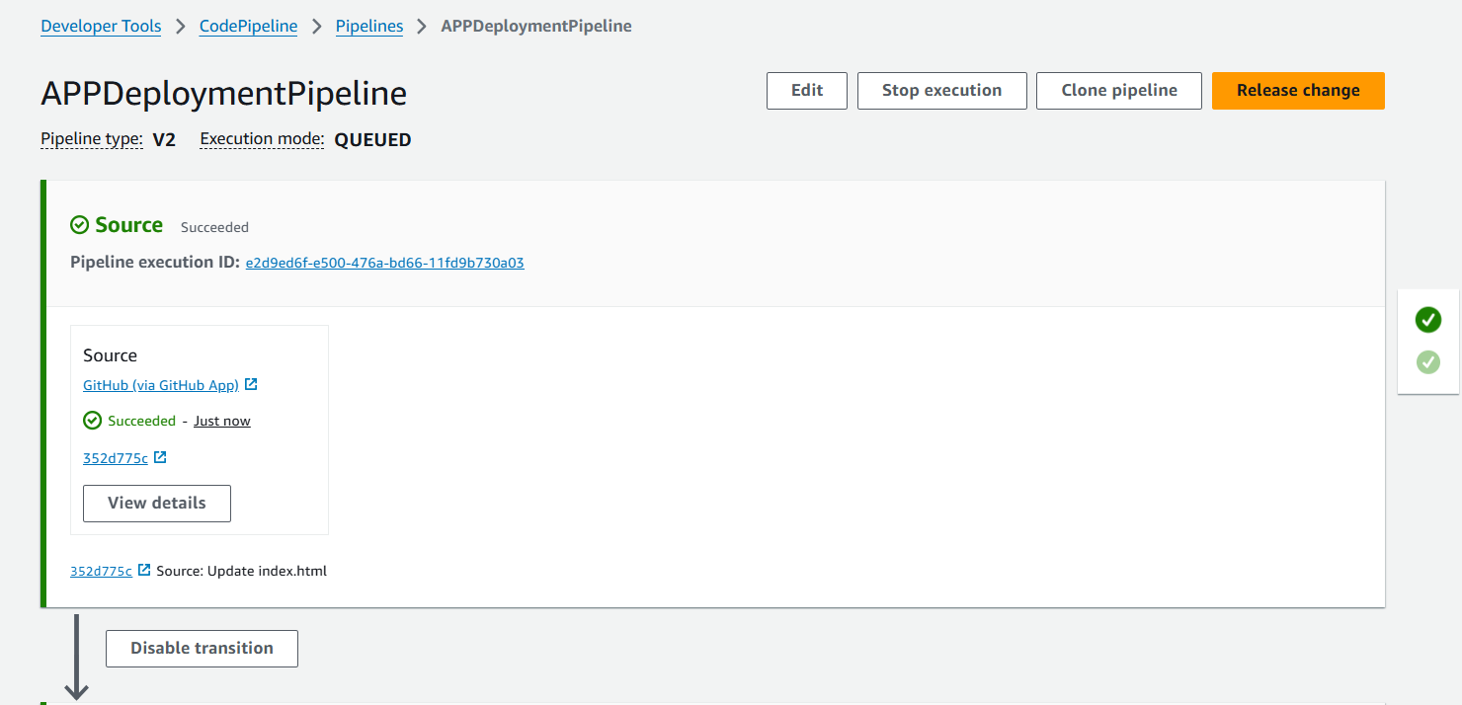
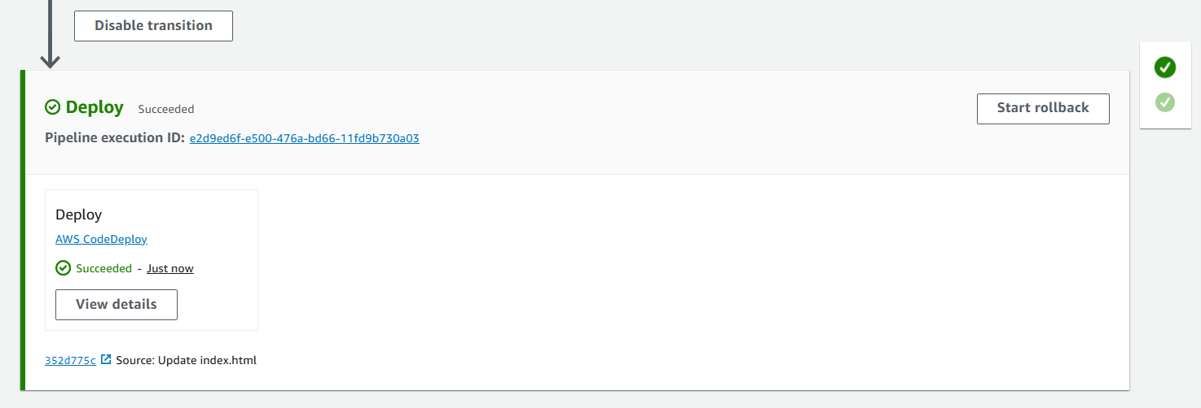
Step5: After creating the pipeline It will checks the Git repository and Deploy the Application in to the server

Slide 12
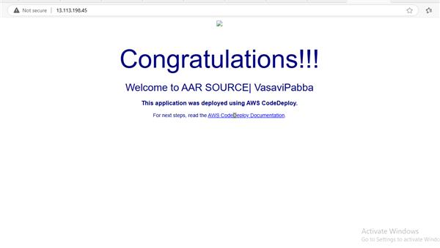
Step6: We can see the Output by using EC2 Instance DNS link
Conclusion:
AWS CodeDeploy simplifies and automates deployments, reducing human errors and ensuring consistency across environments. By integrating CodeDeploy into your CI/CD pipeline, you can achieve fast, reliable, and scalable application delivery.

